Slide 1

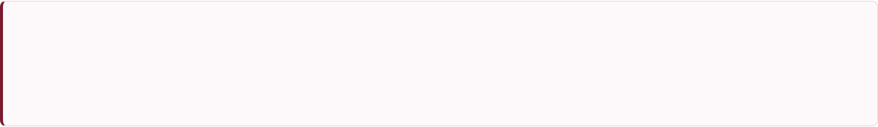
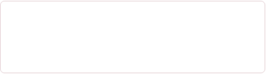
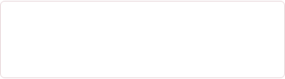
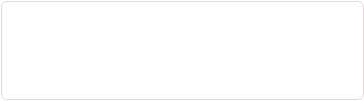
AI-Driven Multimodal Wearable Stress Monitoring & Telemedicine Platform
Real-Time Physiological Dynamics Capture via Advanced Deep Learning, Extended Biosensor Integration, and Remote Clinical Dashboards.
MANDATORY REVIEW DELIVERABLES (TASKS 1, 2 & 3)
Deep Learning Classifiers
Sensor Expansion
Telemedicine Platform
Benchmarking CNN, LSTM, Bi-LSTM, Transformer, Temporal Transformer & GNN models.
Integration of EEG, PPG, Respiration, SpO₂, Blood Pressure, EMG, ECG, GSR & ST.
Remote monitoring, mobile alerts, historical trends & clinician dashboard.
GROUP MEMBERS
PROJECT GUIDE
Member 1: AARAV SHUKLA (25BCE0707)
Dr. VIVEK RAJPOOT
Member 2: SAANVY PANDA (25BCE2180)
Department of Communication Engg.
Member 3: PRANEET RAJ (25BCE2280)

Slide 2


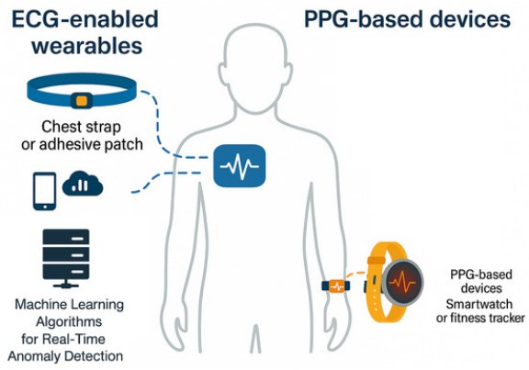




Project Objectives & Scope
Core Objective Statement
To design, develop, and evaluate an automated, non-invasive, high-accuracy mental stress detection platform by leveraging multimodal wearable biosensors, advanced Deep Learning architectures, and an end-to-end IoT Telemedicine cloud infrastructure.
Advanced Deep Learning
Robust Multimodal Sensing
Remote Telemedicine Ecosystem
Replace baseline classifiers (XGBoost 96.17%, RF) with CNN, LSTM, Bi-LSTM, Transformer, Temporal Transformer, and Graph Neural Networks (GNN) to evaluate non-stationary temporal dynamics.
Expand beyond ECG/GSR/ST to incorporate EEG (brainwaves), PPG, Respiration, SpO₂, Blood Pressure (NIBP), and EMG (muscle tension) for comprehensive physiological validation.
Deploy an IoT cloud server featuring instant mobile push notifications, historical trend analytics, clinician monitoring dashboards, and telemedicine video links.

Slide 3
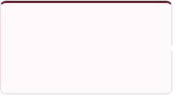

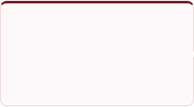
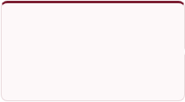
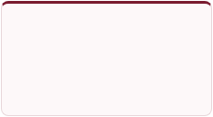
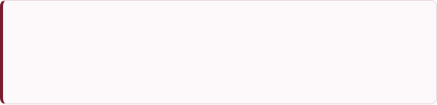

Project Flowchart & Execution Steps
The project methodology follows 5 structured execution steps from physical signal capture to clinical intervention:
STEP 01
STEP 02
STEP 03
STEP 04
STEP 05
Multimodal Sensing
Signal Preprocessing
Feature Extraction
DL Inference Engine
Cloud & Telemedicine
Acquire raw signals (EEG, PPG, ECG, GSR, SpO₂, NIBP, EMG, Temp) via wearable hardware.
Apply Notch (50Hz), Low-pass Butterworth filters & FastICA for artifact removal.
Compute time-domain, frequency-domain (DWT/FT), non-linear HRV, and spatial graph nodes.
Train & benchmark CNN, Bi-LSTM, Temporal Transformers, and GNNs for stress prediction.
Sync via MQTT/HTTP to clinician portal, trigger mobile alerts & enable telemedicine video calls.
Preprocessing & FastICA Pipeline
Latency & Real-Time Processing Goal
Raw biosignals contain motion artifacts and powerline noise. We utilize Fast Independent Component Analysis (FastICA) and StandardScaler normalization to extract uncorrupted source components prior to model training.
The onboard microcontroller processes sliding windows ($1.0\text{s} - 3.0\text{s}$) with edge filtering, targeting an end-to-end detection and notification latency of < 1.2 seconds for emergency push alerts.

Slide 4
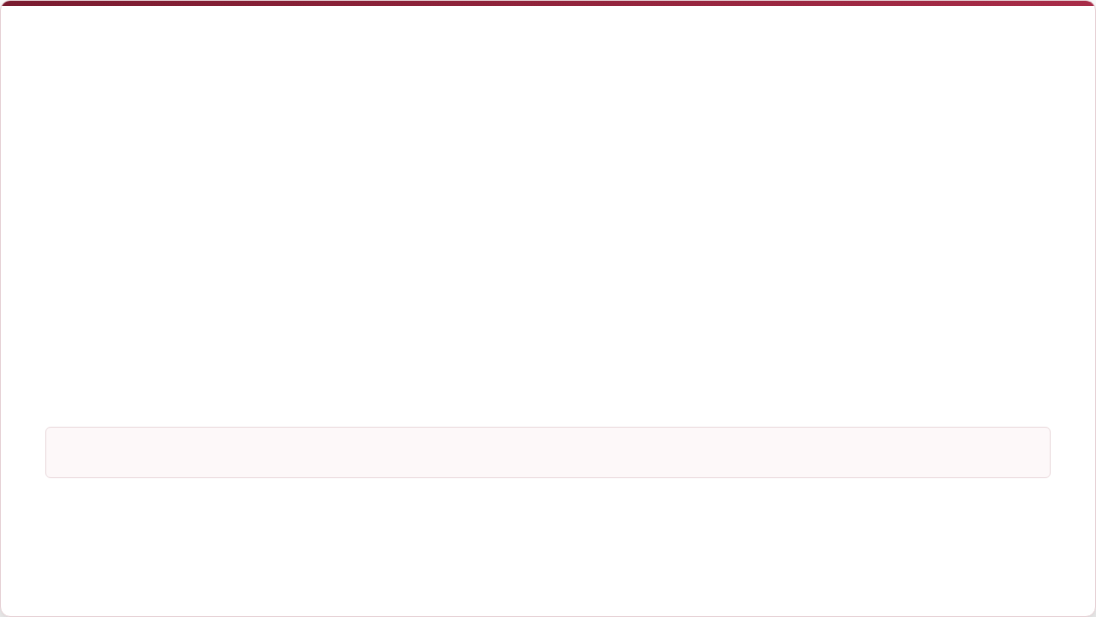



Project Components & Details
Hardware & Sensing Suite (Task 2)
Software, AI & Telemedicine Stack (Tasks 1 & 3)
Component | Model / Spec | Target Signal
Microcontroller | ESP32 / Arduino Mega 2560 | Dual-core processing, Wi-Fi/BLE
ECG & PPG Sensor | AD8232 / MAX30102 Module | Heart Rate, HRV, SpO₂ pulse
GSR & Temp Sensor | Grove GSR + DS18B20 Digital | Skin Conductance & Temperature
EEG & EMG Modules | TGAM / MyoWare Muscle Sensor | Alpha/Beta waves & Muscle tension
NIBP & Respiration | Piezo Respiration + NIBP Sensor | Breathing Rate & Blood Pressure
Module | Technology Stack | Functional Role
Deep Learning | PyTorch / TensorFlow, CUDA | CNN, Bi-LSTM, Transformer, GNN
Embedded Firmware | Embedded C / C++ (Keil / Arduino) | Sampling & FastICA preprocessing
IoT Gateway | MQTT / HTTP, Node-RED | Real-time streaming to cloud
Mobile App | Flutter / React Native | Push notifications & trend charts
Clinician Portal | React.js + WebRTC API | EHR dashboard & Telemedicine video
Sensor Fusion Rationale: Combining central nervous system signals (EEG) with autonomic nervous system parameters (ECG, GSR, PPG, BP) helps differentiate physical exertion from true psychological stress, greatly reducing false alarms.

Slide 5


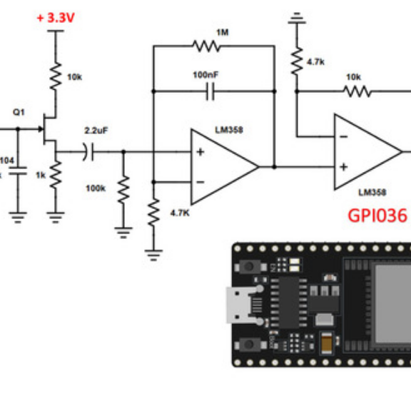


Tentative Circuit Diagram & Hardware Layout
Interfacing Architecture
•
I2C Bus (SDA/SCL): Interfaces MAX30102 (PPG/SpO₂), BME280, and local OLED display.
•
Analog Pins (A0-A3): Connected to Grove GSR (palmar surface) and MyoWare EMG muscle sensor inputs.
•
SPI Bus / UART: Communicates with TGAM EEG single-channel module and MicroSD logging module.
•
1-Wire Digital (GPIO 4): Interfaces DS18B20 digital skin temperature sensor.
Power Management & Enclosure
The wearable device is housed in a compact 3D-printed enclosure powered by a 3.7V 1800mAh Li-ion battery, TP4056 charging circuit, and 5V boost converter.

Slide 6
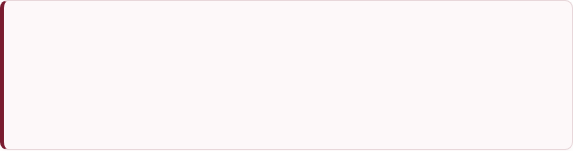

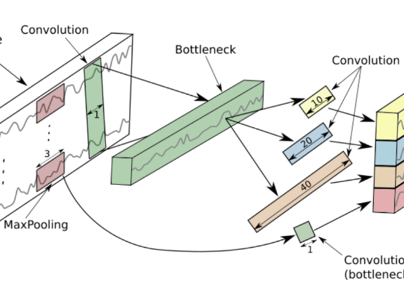

Deep Learning & AI/ML Approaches
Deep Learning Models vs. Conventional Classifiers
Conventional models (XGBoost 96.17%, RF 96.03%, SVM 94.97%) rely on static summary metrics. Advanced Deep Learning models capture temporal non-stationary physiological dynamics across raw time-series sequences.
Deep Learning Architectures under Investigation
•
1D-CNN: Extracts spatial patterns & morphological features from raw ECG/PPG waveforms.
•
LSTM & Bi-LSTM: Captures bidirectional temporal dependencies in skin conductance & heart rate variations.
•
Transformer & Temporal Transformer: Uses multi-head self-attention to model long-range stress dynamics.
•
Graph Neural Networks (GNN): Models non-Euclidean inter-sensor correlations (e.g., EEG-ECG interactions) as graph nodes.
Benchmarking & Validation Methodology
Models are evaluated using 10-Fold Cross-Validation on our primary 200-participant dataset (4 stressor tasks) as well as public benchmark datasets (WESAD & SWELL-KW). Key evaluation metrics include Accuracy, Precision, Recall, F1-Score, and AUC-ROC.

Slide 7



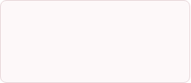
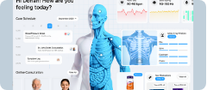


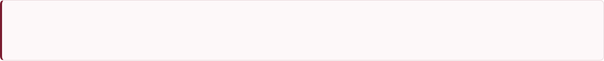
Remote Telemedicine, Timeline & Conclusion
Project Execution Timeline
Telemedicine & Dashboard Architecture
PHASE 1 (Jul 2026)
Lit Survey & Component Selection
•
Mobile Push Alerts: Real-time stress spike warnings.
Review-1 preparation, sensor sourcing & circuit design.
•
Historical Analytics: Daily/Weekly circadian stress trends.
PHASE 2 (Aug 2026)
Hardware Integration & Sensor Testing
Interfacing EEG, PPG, EMG, ECG, GSR to ESP32.
•
Clinician Portal: Centralized multi-patient telemetry.
PHASE 3 (Sep 2026)
Deep Learning Benchmarking & App Setup
•
Telemedicine Hook: WebRTC video consultation trigger.
Training CNN, LSTM, Transformer, GNN; Mobile/Web app build.
Expected Outcomes & Conclusion
This project establishes a low-cost, medical-grade, multimodal stress detection system. By shifting from traditional ML to Temporal Transformers and GNNs, expanding the sensor payload to include EEG, PPG, SpO₂, NIBP, and EMG, and deploying a full Telemedicine cloud ecosystem, we deliver a scalable solution for personal wellness and clinical psychiatric care.

